Slide 1

Watson Conversation
Service

Slide 2
Agenda
Conversation Service Introduction
Key concepts
Usecase and Lab design
Hands on
Conversation Service – Advanced

Slide 3
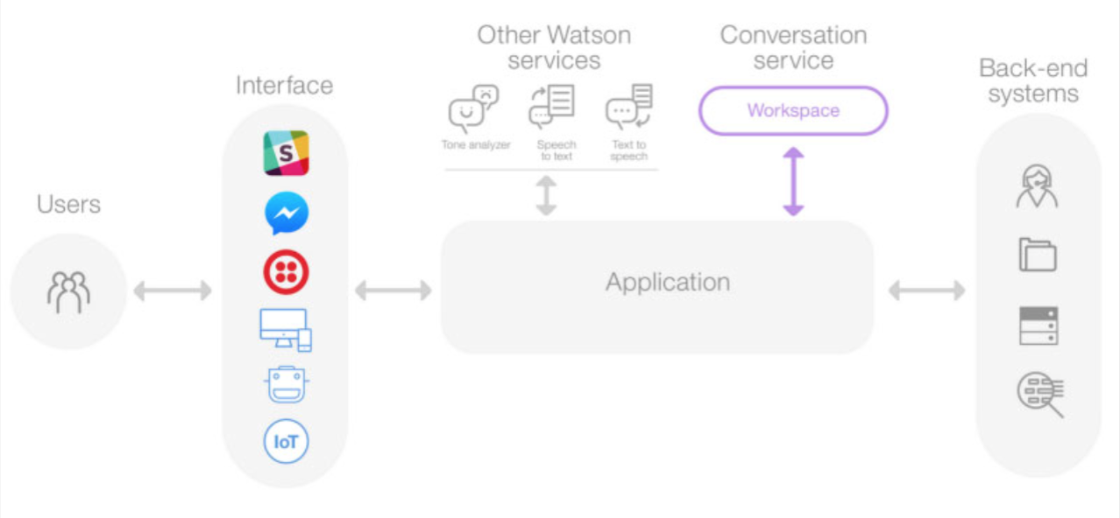
Typical Architecture of an Application Using Conversation Service

Slide 4
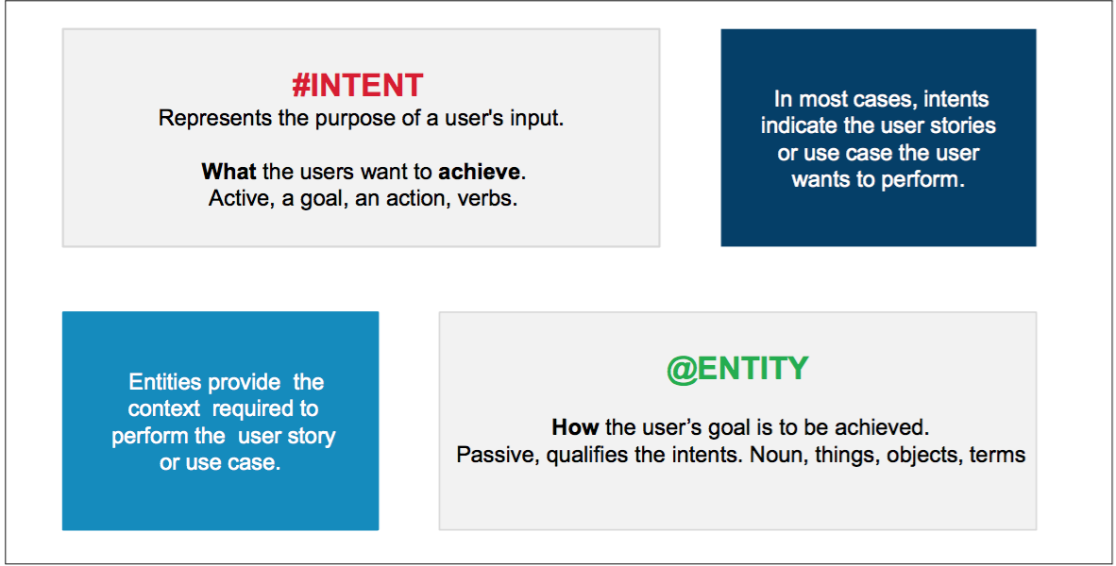
Conversation Concepts – Intents and Entities
Conversation service uses a natural language processing (NLP) to identify key information from user’s interactions
Intent: The purpose of a user’s input (the user’s intent)
Entity: A term or object that is relevant to the intent (context for the intent).
The dialog component of the Conversation service uses the intents and entities that are identified in the user’s input to gather required information and provide a useful response to each user input

Slide 5
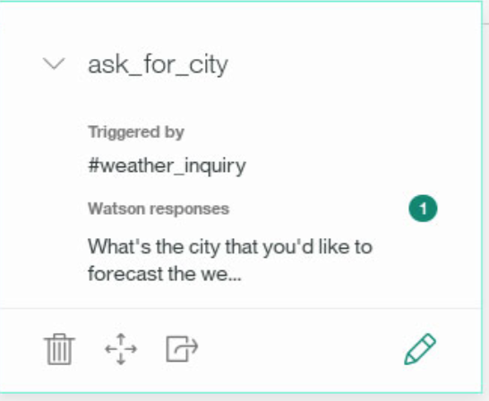
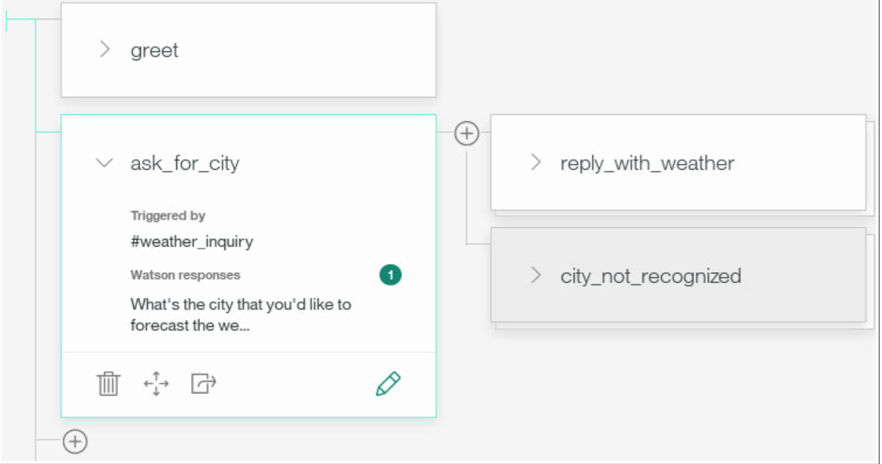
Concepts – Node and Dialog
Node Name
Each node starts with one or more lines that the bot shows to the user to request a response. Each node includes conditions for the node to be active, and also an output object that defines the response provided
Dialog: The dialog is made up of nodes that define steps in the conversation. Dialog nodes are chained together in a tree structure to create an interactive conversation with the user.
Trigger
Condition
Response text

Slide 6
Lets Understand through example – Identify intents and entities in the below statements
I want to know about your life insurance product
I am totally unhappy with your customer service representative who visited my home
When is my insurance premium due?
I am going to escalate this matter to your senior management
Hi there! How are you doing today?
Nope, thx am done.
I rate you 5 out of 10

Slide 7
Conversation Turn
A single cycle of user input and a response is called conversation turn . Each conversation turn starts in one dialog node, called the active node.
5
4
1
3
2

Slide 8
Typical Conversation Flow
The conversation starts in an initial node setup with the conversation_start special condition.
After some conversation turns,the dialog progresses to the node marked as active node. The response configured in this node is shown to the user. The user input is analyzed for intents and entities and used to select the next dialog node in the flow.
The conditions in the child nodes are evaluated in descending order using the extracted intents and entities. The first child node to match a condition is selected as the next active node and a new conversation turn starts.
If no child node matches the condition, the Conversation service evaluates the conditions of each base node in the dialog and selects the first matching dialog node as the next active node.
A useful approach is to have a base node configured with the anything_else special condition so that the conversation defaults to this node when no other nodes match the conditions. The special anything_else condition always evaluates to true. You can use this node in the dialog to tell the user that the input was not understood and suggest valid interaction.

Slide 9
Conversation Service – A quick tour
Configuring or Importing Intents and Entities
Importing and exporting a conversation flow
Parts of a node
Addition of a new node and ’anything else’ node
What is Fuzzy Logic for entities?
What are system entities?
What are the built analytics available for an existing chat bot ?
What is language used to script the conditions?

Slide 10
Conversation Service – Watson Developer Cloud
API
https://www.ibm.com/watson/developercloud/conversation/api/v1/
Watson API explorer to test APIs
To interact with this REST API, use the Conversation service API explorer. Use the explorer to test your calls to the API and to view live responses from the server.

Slide 11
Typical Conversation Service Req and Res structure in a REST call
Conversation Service Request
Conversation Service Response

Slide 12
Conversation Service and Application – Context exchange
Context is a key element of the request and response that is exchanged between the application and the conversation service.

Slide 13
Lab exercise Use case
Cognitive calculator is a simple chat bot application that understands users intent to add or multiple two numbers, performs the operation and returns the result.
Objective of the Lab exercise :
To apply the fundamental concepts learnt about the conversation service and successfully perform the following activities
Create a Conversation service instance in IBM Bluemix.
Create a Conversation workspace, add intents, entities, system entities, and a dialog for the Cognitive Calculator chatbot application.
Integrate the Watson Conversation service in a Node.js application to perform the calculation functionality.

Slide 14
Application Design

Slide 15
Conversation Service – Advanced Topics
- Conversation Service Design Patterns
- Botkit Integration:
https://www.ibm.com/blogs/watson/2016/11/new-botkit-integration-makes-deploying-watson-bots-messaging-apps-easy/

